Slide 1

Introduction to ML strategy
Why ML
Strategy?
deeplearning.ai

Slide 2
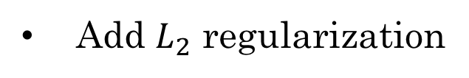

Motivating example
Ideas:
Collect more data
Try dropout
Collect more diverse training set
Add $L_{2}$ regularization
Train algorithm longer with gradient descent
Network architecture
Try Adam instead of gradient descent
Activation functions
Try bigger network
# hidden units
Try smaller network
…

